Slide 1
Capstone Report
Analysis of F-Score’s effectiveness as an investment tool

Slide 2
Introduction – F-Score
Developed by Joseph D. Piotroski
Based on Accounting-Based Fundamental Analysis
Simple and Accessible
Score is tabulated from 0-9, correlating with company’s financial performance & health
  (0-1) Low F-Score Group, High F-Score Group (8-9)

Slide 3
F-Score Overview
F-Score Indicators
Profitability
Change in Current Ratio
Operating Efficiency
Change in Gross Margin
Leverage, Liquidity, and Source of Funds
Return on Assets (ROA)
Operating Cash Flow (CFO)
Change in ROA
Change in Accruals
Change in Leverage
Change in Number of Shares
Change in Asset Turnover

Slide 4
F-Score Limitations
F-Score is highly dependent on elements affecting the financial reporting standards
  Accessibility
  Timeliness
  Transparency
  Accountability
  Consistency
  Comparability (Sector/Region-Based)

Slide 5
Research Motivation
Expanding the applicability of F-Score to all companies
Updating testing samples to more recent companies to take into account the following changes
  Industry Trends
  Business Cycles
  Developments in Financial Reporting Standards

Slide 6
Hypothesis
Hypothesis 1:
  The difference between High F-Score and Low F-Score group’s market-adjusted return = 0
Hypothesis 2:
  The High/Low grouping based on F-Score is consistent with the original F-Score grouping
Hypothesis 3:
  Changing increase in number of shares as a positive indicator yields lesser or no difference in returns (<=Original F-Score)
Hypothesis 4:
  If Hypothesis 1 is null, the difference between High F-Score and Low F-Score group’s market-adjusted return across different industries < 0
Hypothesis 5
  If Hypothesis 1 is null, the difference between High F-Score and Low F-Score group’s market-adjusted return across different years is < 0

Slide 7
Research OVERVIEW
Data Collection/Wrangling Process

Slide 8
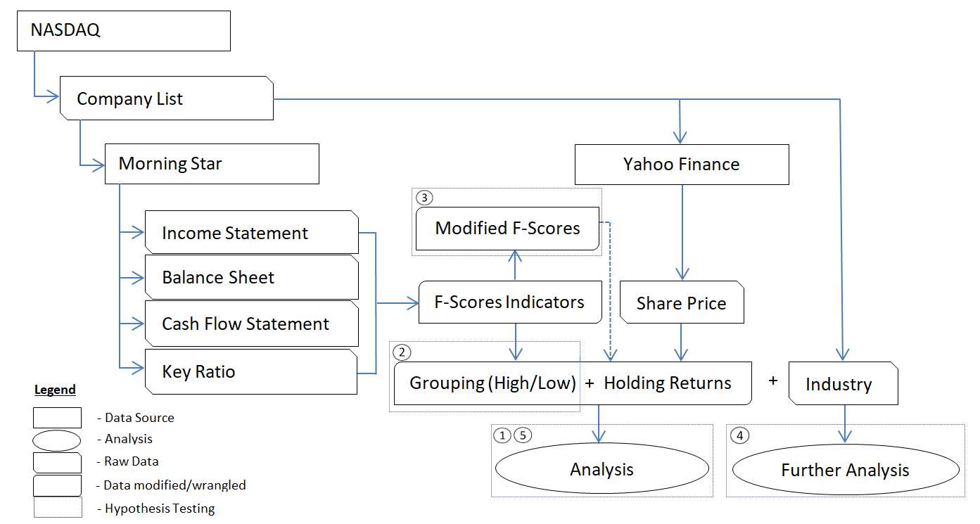
Data Collection/Wrangling Process

Slide 9
Research Findings

Slide 10
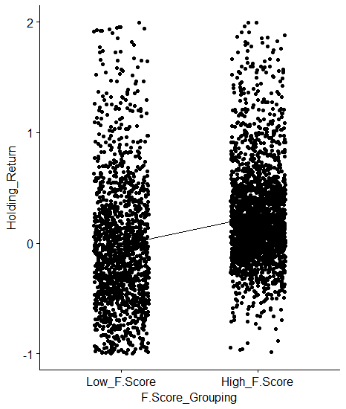
Findings: Hypothesis 1
F-Score still maintains its effectiveness in identifying companies with superior returns and subpar returns
  Difference is around 26.8%

Slide 11
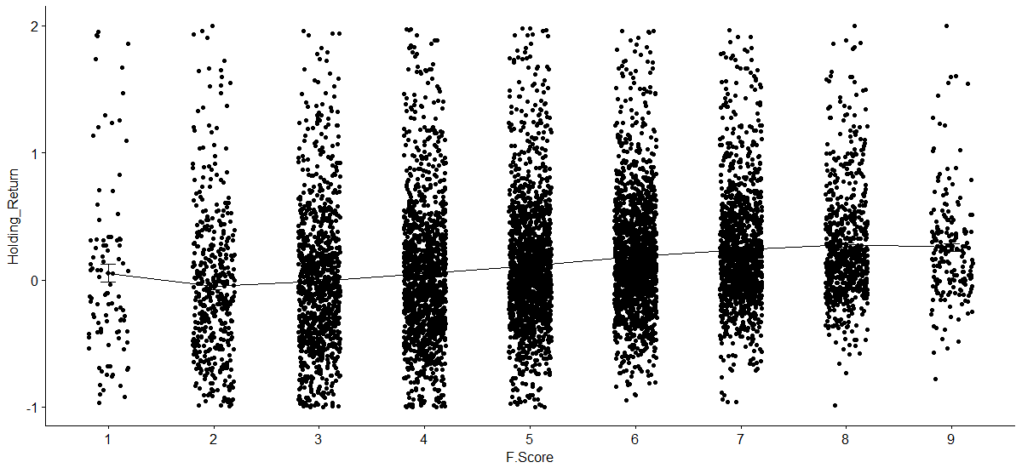
Findings: Hypothesis 2
Empirical results show that the original F-Score grouping can optionally include other F-Score to enhance returns.
  Low grouping (0-3), High grouping (7-9)

Slide 12
Findings: Hypothesis 3
Changing F-Score indicator "Increase in number of shares" from a negative indicator to a positive indicator does not yield significantly higher returns.

Slide 13
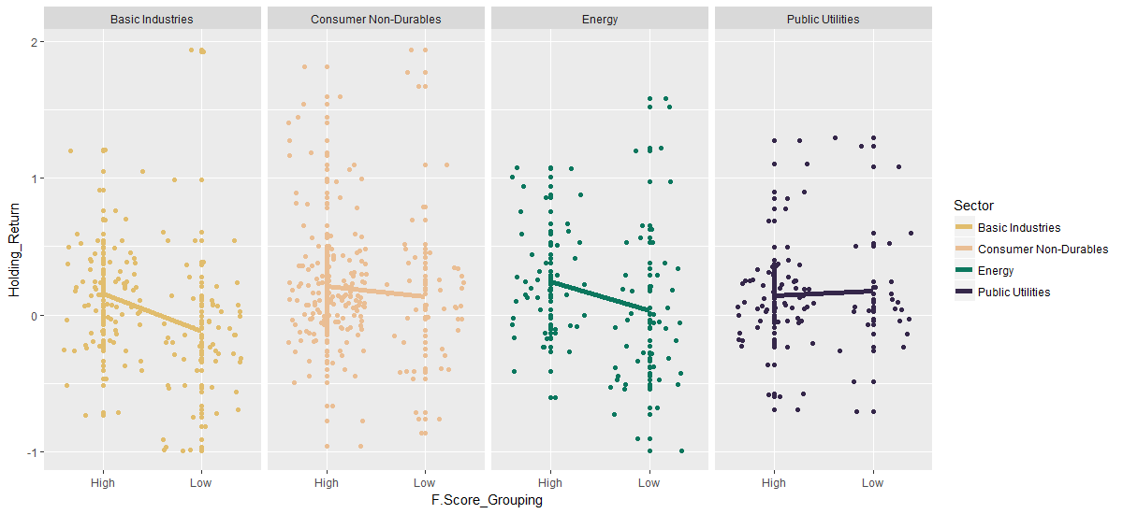
Findings: Hypothesis 4
Empirical results show that the effectiveness of F-Score varies across different sectors.
  Sectors affected are Public Utilities, Energy, and Consumer Non-Durables

Slide 14
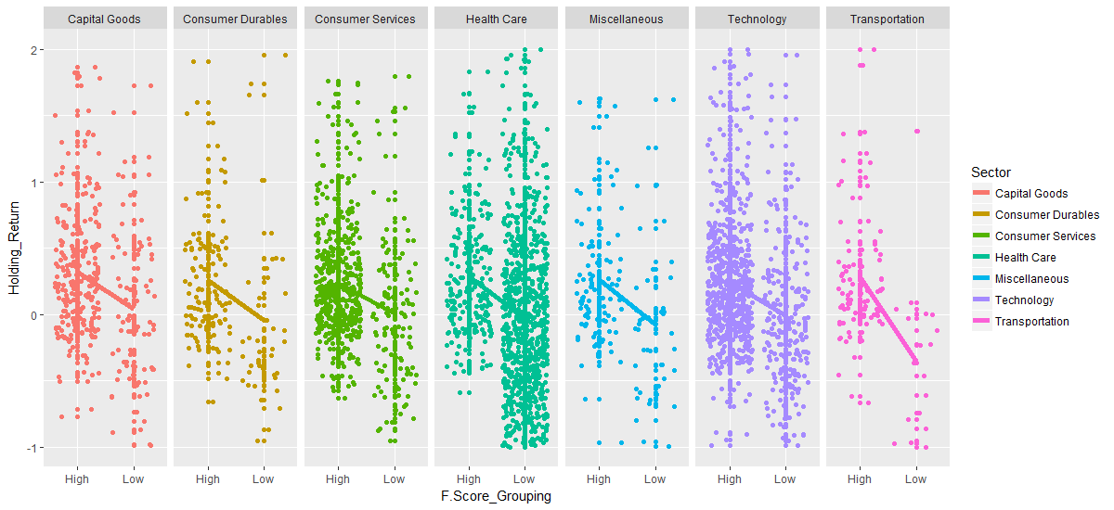
Findings: Hypothesis 4 (Part 2)
These sectors are also included in the test

Slide 15
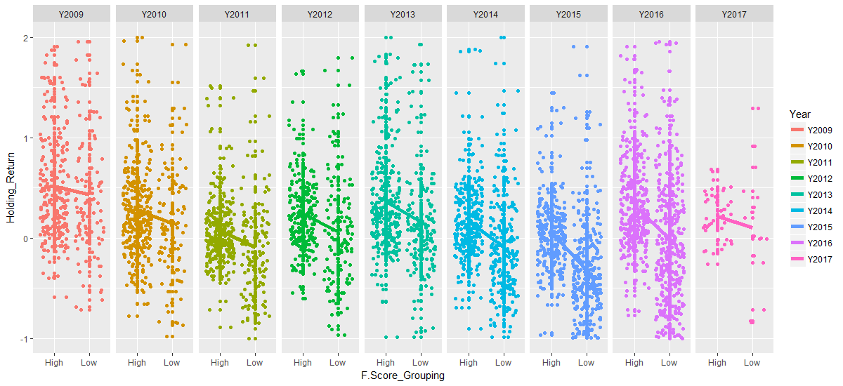
Findings: Hypothesis 5
Empirical results show that the effectiveness of F-Score varies across the years.
  Year 2009 is not effective

Slide 16
Research Conclusion and applications
Theoretical and Practical Aspects

Slide 17
Theoretical aspect
"Change in number of shares“ indicator is not an effective indicator
Financial Theory Implications
  Confirms the inefficient market hypothesis
  Not consistent with the Pecking Order Theory

Slide 18
Practical Aspects
Regarding the application of F-Score, modifications can be made to further enhance the returns
  Extending the F-Score groupings or
  Focus specifically on certain industries.
Nevertheless, relying solely on financial performance to predict holding returns is not as effective as returns are affected by both company and economic specific factors.

Slide 19
Practical Aspects (Investment Strategies)
Longing high F-Score companies
  Exposure to both companies and market risks.
Buying the indices will provide
  Exposure to market risks while eliminating company-specific risk.
Longing high F-Score and shorting low F-Score (also known as market neutral strategy)
  Exposure to company risks exposure and partially eliminate market risks.
Execute the above 3 strategies in specific sectors
  Exposure to sector risks.

Slide 20
THE END

